Slide 1
Introduction to
HTML
Presented by Dr.Sm.Badhusha
Professor/CSE

Slide 2
Definitions
HTML : HyperText Markup Language – The Language of Web Pages on the World Wide Web.
HTML is a text formatting language.
URL : Uniform Resource Locator.
Browser :A software program which is used to show webpages.
WWW: A collection of websites or web pages stored in web servers.Building blocks of webpages connected by hyperlinks and HTTP

Slide 3
“Normal text” surrounded by bracketed tags that tell browsers how to display web pages
Pages end with “.htm” or “.html”
Hypertext Markup Language, a standardized system for tagging text files to achieve font, colour, graphic, and hyperlink effects on World Wide Web pages.
Notes:
09/22/97
3
University of Minnesota Extension Service
Master Internet Volunteer Program
Provide information in an organized way
Chat Groups
Specialized information areas
Internet access

Slide 4
Tags
Codes enclosed in brackets
Usually paired
  <TITLE>My Web Page</TITLE>
Not case sensitive
  <TITLE> = <title> = <TITLE>
  But preferably upper case is used

Slide 5
Creating a Basic Starting Document
  <HTML>
  <HEAD>
  <TITLE>Alva’s Institute of Engineering &Technology</TITLE>
  </HEAD>
  <BODY>
  Hello!,This is the official page of the AIET
</BODY>
  </HTML>
Notes:
09/22/97
9
University of Minnesota Extension Service
Master Internet Volunteer Program
Tech help should be a local or toll-free call
Is it available when you are using the net?
Will you get a real person or have to leave voice mail? (voice mail is OK if the response time is fast and during a time you are not connected)
Try calling tech support before subscribing.

Slide 6
Creating a Basic Starting Document
The HEAD of your document point to above window part. The TITLE of your document appears in the very top line of the user’s browser.
The text in your TITLE should be as descriptive as possible because this is what many search engines, on the internet, use for indexing your site.

Slide 7
Setting Document Properties
Document properties are controlled by attributes of the BODY element. For example, there are color settings for the background color of the page, the document’s text and different states of links.
<BODY BGCOLOR=“#FFFFFF” text=#000000></BODY>

Slide 8
Color Codes
Colors are set using “RGB” color codes, which are, represented as hexadecimal values. Each 2-digit section of the code represents the amount, in sequence, of red, green or blue that forms the color. For example, a RGB value with 00 as the first two digits has no red in the color.

Slide 9

Main Colours

Slide 10
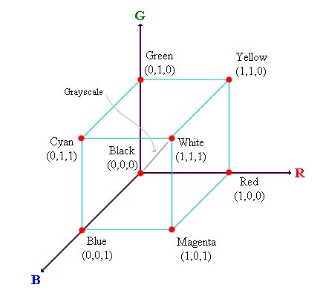
RGB Colour Model

Slide 11
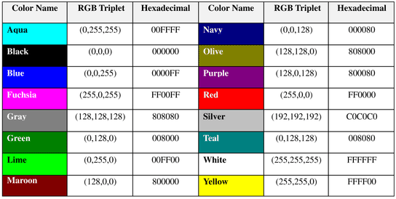
16 Basic Colors

Slide 12
Color Codes
WHITE
BLACK
RED
GREEN
BLUE
MAGENTA
CYAN
YELLOW
AQUAMARINE
BAKER’S CHOCOLATE
VIOLET
BRASS
COPPER
PINK
ORANGE
#FFFFFF
#000000
#FF0000
#00FF00
#0000FF
#FF00FF
#00FFFF
#FFFF00
#70DB93
#5C3317
#9F5F9F
#B5A642
#B87333
#FF6EC7
#FF7F00

Slide 13
The Body Element
The BODY element of a web page is an important element in regards to the page’s appearance. Here are the attributes of the BODY tag to control all the levels:
TEXT="#RRGGBB" to change the color of all the text on the page (full page text color.)
This element contains information about the page’s background color, the background image, as well as the text and link colors.

Slide 14
Background Color
It is very common to see web pages with their background color set to white or some other colors.
To set your document’s background color, you need to edit the <BODY> element by adding the BGCOLOR attribute. The following example will display a document with a white background color:
<BODY BGCOLOR=“#FFFFFF”></BODY>

Slide 15
TEXT Color
The TEXT attribute is used to control the color of all the normal text in the document. The default color for text is black. The TEXT attribute would be added as follows:
<BODY BGCOLOR=“#FFFFFF” TEXT=“#FF0000”></BODY>
In this example the document’s page
color is white and the text would be red.

Slide 16
Using Image Background
The BODY element also gives you ability of setting an image as the document’s background.
An example of a background image’s HTML code is as follows:
<BODY BACKGROUND=“hi.gif” BGCOLOR=“#FFFFFF”></BODY>

Slide 17
Headings, <Hx> </Hx>
Inside the BODY element, heading elements H1 through H6 are generally used for major divisions of the document. Headings are permitted to appear in any order, but you will obtain the best results when your documents are displayed in a browser if you follow these guidelines:
H1: should be used as the highest level of heading, H2 as the next highest, and so forth.
You should not skip heading levels: e.g., an H3 should not appear after an H1, unless there is an H2 between them.

Slide 18
Headings, <Hx> </Hx>
<HTML>
<HEAD>
<TITLE> Example Page</TITLE>
</HEAD>
<BODY>
<H1> Heading 1 </H1>
<H2> Heading 2 </H2>
<H3> Heading 3 </H3>
<H4> Heading 4 </H4>
<H5> Heading 5 </H5>
<H6> Heading 6 </H6>
</BODY>
</HTML>
Heading 1
Heading 2
Heading 3
Heading 4
Heading 5
Heading 6

Slide 19
Paragraphs, <P> </P>
Paragraphs allow you to add text to a document in such a way that it will automatically adjust the end of line to suite the window size of the browser in which it is being displayed. Each line of text will stretch the entire length of the window.

Slide 20
Paragraphs, <P> </P>
<HTML><HEAD>
<TITLE> Example Page</TITLE>
</HEAD>
<BODY></H1> Heading 1 </H1>
<P> Paragraph 1, ….</P>
<H2> Heading 2 </H2>
<P> Paragraph 2, ….</P>
<H3> Heading 3 </H3>
<P> Paragraph 3, ….</P>
<H4> Heading 4 </H4>
<P> Paragraph 4, ….</P>
<H5> Heading 5 </H5>
<P> Paragraph 5, ….</P>
<H6> Heading 6</H6>
<P> Paragraph 6, ….</P>
</BODY></HTML>
Heading 1
Paragraph 1,….
Heading 2
Paragraph 2,….
Heading 3
Paragraph 3,….
Heading 4
Paragraph 4,….
Heading 5
Paragraph 5,….
Heading 6
Paragraph 6,….

Slide 21
Break, <BR>
Line breaks allow you to decide where the text will break on a line or continue to the end of the window.
A <BR> is an empty Element, meaning that it may contain attributes but it does not contain content.
The <BR> element does not have a closing tag.

Slide 22
Break, <BR>
<HTML>
<HEAD>
<TITLE> Example Page</TITLE>
</HEAD>
<BODY>
<H1> Heading 1 </H1>
<P>Paragraph 1, <BR>
Line 2 <BR> Line 3 <BR>….
</P>
</BODY>
</HTML>
Heading 1
Paragraph 1,….
Line 2
Line 3
….

Slide 23
Horizontal Rule, <HR>
The <HR> element causes the browser to display a horizontal line (rule) in your document.
<HR> does not use a closing tag, </HR>.

Slide 24
Horizontal Rule, <HR>
<HTML>
<HEAD>
<TITLE> Example Page</TITLE>
</HEAD>
<BODY>
<H1> Heading 1 </H1>
<P>Paragraph 1, <BR>
Line 2 <BR>
<HR>Line 3 <BR>
</P>
</BODY>
</HTML>
Heading 1
Paragraph 1,….
Line 2
___________________________
Line 3

Slide 25
Bold, Italic and other Character Formatting Elements
<FONT SIZE=“+2”> Two sizes bigger</FONT>
The size attribute can be set as an absolute value from 1 to 7 or as a relative value using the “+” or “-” sign. Normal text size is 3 (from -2 to +4).
<B> Bold </B>
<I> Italic </I>
<U> Underline </U>
Color = “#RRGGBB” The COLOR attribute of the FONT element. E.g., <FONT COLOR=“#RRGGBB”>this text has color</FONT>
<PRE> Preformatted </PRE> Text enclosed by PRE tags is displayed in a mono-spaced font. Spaces and line breaks are supported without additional elements or special characters.

Slide 26
Bold, Italic and other Character Formatting Elements
<EM> Emphasis </EM> Browsers usually display this as italics.
<STRONG> STRONG </STRONG> Browsers display this as bold.
<TT> TELETYPE </TT> Text is displayed in a mono-spaced font. A typewriter text, e.g. fixed-width font.
<CITE> Citation </CITE> represents a document citation (italics). For titles of books, films, etc. Typically displayed in italics. (A Beginner's Guide to HTML)

Slide 27
Bold, Italic and other Character Formatting Elements
<P> <FONT SIZE=“+1”> One Size Larger </FONT> - Normal –
<FONT SIZE=“-1”> One Size Smaller </FONT> <BR>
<B> Bold</B> - <I> italics</I> - <U> Underlined </U> -
<FONT COLOR=“#FF0000”> Colored </FONT> <BR>
<EM> Emphasized</EM> - <STRONG> Strong </STRONG> - <TT> Tele Type </TT> <BR>
One Size Larger - Normal – One Size Smaller
Bold - italics - Underlined - Colored
Emphasized - Strong - Tele Type

Slide 28
Alignment
Some elements have attributes for alignment (ALIGN) e.g. Headings, Paragraphs and Horizontal Rules.
The Three alignment values are : LEFT, RIGHT, CENTER.
<CENTER></CENTER> Will center elements.

Slide 29
Alignment
<DIV ALIGN=“value”></DIV> Represents a division in the document and can contain most other element type. The alignment attribute of the DIV element is well supported.
<TABLE></TABLE> Inside a TABLE, alignment can be set for each individual cell.

Slide 30
Special Characters & Symbols
These Characters are recognized in HTML as they begin with an ampersand and end with with a semi-colon e.g. &value; The value will either be an entity name or a standard ASCII character number. They are called escape sequences.
The next table represents some of the more commonly used special characters. For a comprehensive listing, visit the W3C’s section on special characters at: http://www.w3.org/MarkUp/HTMLPlus/htmlplus_13.html

Slide 31
Special Characters & Symbols
Special Character | Entity Name | Special Character | Entity Name
Ampersand | &amp; & | Greater-than sign | &gt; >
Asterisk | &lowast; ∗∗ | Less-than sign | &lt; <
Cent sign | &cent; ¢ | Non-breaking space | &nbsp;
Copyright | &copy; © | Quotation mark | &quot; "
Fraction one qtr | &frac14; ¼ | Registration mark | &reg; ®
Fraction one half | &frac12; ½ | Trademark sign | &trade; ™

Slide 32
Additional Character Formatting Elements
<STRIKE> strike-through text</STRIKE>
DEL is used for STRIKE at the latest browsers
<BIG> places text in a big font</BIG>
<SMALL> places text in a small font</SMALL>
<SUB> places text in subscript position </SUB>
<SUP> places text in superscript style position </SUP>

Slide 33
Example
<P><STRIKE> strike-through text </STRIKE></BR>
<BIG>places text in a big font </BIG><BR>
<SMALL> places text in a small font</SMALL><BR>
<SUB> places text in subscript position </SUB>
Normal
<SUP> places text in superscript style position </SUP><BR> </P>

Slide 34
List Elements
HTML supplies several list elements. Most list elements are composed of one or more <LI> (List Item) elements.
UL : Unordered List. Items in this list start with a list mark such as a bullet. Browsers will usually change the list mark in nested lists.
<UL>
<LI> List item …</LI>
<LI> List item …</LI>
</UL>
List item …
List item …

Slide 35
List Elements
You have the choice of three bullet types: disc(default), circle, square.
These are controlled in Netscape Navigator by the “TYPE” attribute for the <UL> element.
<UL TYPE=“square”>
<LI> List item …</LI>
<LI> List item …</LI>
<LI> List item …</LI>
</UL>
List item …
List item …
List item …

Slide 36
List Elements
OL: Ordered List. Items in this list are numbered automatically by the browser.
<OL>
<LI> List item …</LI>
<LI> List item …</LI>
<LI> List item …</LI>
</OL>
List item …
List item …
List item
You have the choice of setting the TYPE Attribute to one of five numbering styles.

Slide 37
List Elements
TYPE | Numbering | Styles
1 | Arabic numbers | 1,2,3, ……
a | Lower alpha | a, b, c, ……
A | Upper alpha | A, B, C, ……
i | Lower roman | i, ii, iii, ……
I | Upper roman | I, II, III, ……

Slide 38
List Elements
You can specify a starting number for an ordered list.
<OL TYPE =“i”>
<LI> List item …</LI>
<LI> List item …</LI>
</OL>
<P> text ….</P>
<OL TYPE=“i” START=“3”>
<LI> List item …</LI>
</OL>

Slide 39
List Elements
List item …
List item …
Text ….
List item …

Slide 40
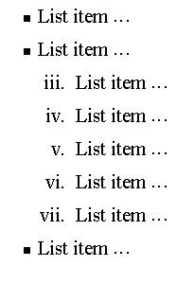
Nesting Lists
You can nest lists by inserting a UL, OL, etc., inside a list item (LI).
EXample
<UL TYPE = “square”>
<LI> List item …</LI>
<LI> List item …
<OL TYPE=“i” START=“3”>
<LI> List item …</LI>
<LI> List item …</LI>
<LI> List item …</LI>
<LI> List item …</LI>
<LI> List item …</LI>
</OL>
</LI>
<LI> List item …</LI>
</UL>

Slide 41
What will be the output?
<
<H1 ALIGN="CENTER">SAFETY TIPS FOR CANOEISTS</H1>
<OL TYPE=“a” START=“2”>
<LI>Be able to swim </LI>
<LI>Wear a life jacket at all times </LI>
<LI>Don't stand up or move around. If canoe tips,
  <UL>
  <LI>Hang on to the canoe </LI>
  <LI>Use the canoe for support and </LI>
  <LI>Swim to shore
  </UL>
  </LI>
<LI>Don't overexert yourself </LI>
<LI>Use a bow light at night </LI>
</OL>

Slide 42
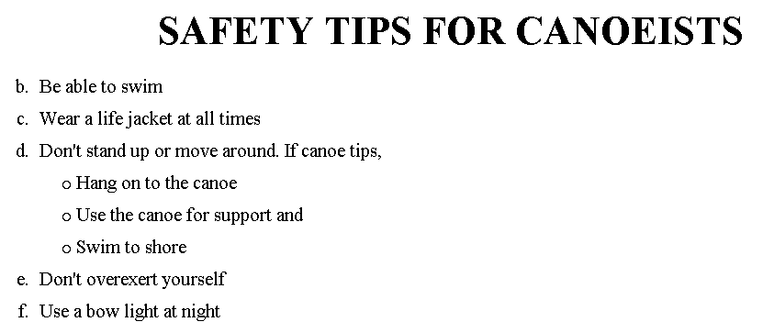
The output….

Slide 43
Images
<IMG>This element defines a graphic image on the page.
Image File (SRC:source): This value will be a URL (location of the image) E.g. http://www.domain.com/dir/file.ext or /dir/file.txt.
Alternate Text (ALT): This is a text field that describes an image or acts as a label. It is displayed when they position the cursor over a graphic image.
Alignment (ALIGN): This allows you to align the image on your page.

Slide 44
Images
Width (WIDTH): is the width of the image in pixels.
Height (HEIGHT): is the height of the image in pixels.
Border (BORDER): is for a border around the image, specified in pixels.
HSPACE: is for Horizontal Space on both sides of the image specified in pixels. A setting of 5 will put 5 pixels of invisible space on both sides of the image.
VSPACE: is for Vertical Space on top and bottom of the image specified in pixels. A setting of 5 will put 5 pixels of invisible space above and bellow the image.

Slide 45
Some Examples on images
1) <IMG SRC=“jordan.gif“ border=4>
2) <IMG SRC=" jordan.gif" width="60" height="60">
3) <IMG SRC=“jordan.gif" ALT="This is a text that goes with the image">
4) <IMG SRC=" jordan.gif “ Hspace="30" Vspace="10" border=20>
5) < IMG SRC =" jordan.gif“ align="left">
blast blast blast blast blast

Slide 46
HOW TO MAKE A LINK
1) The tags used to produce links are the <A>
and </A>. The <A> tells where the link should start and
the </A> indicates where the link ends. Everything between
these two will work as a link.
2) The example below shows how to make the word
Here work as a link to yahoo.
Click <A HREF="http://www.yahoo.com">here</A> to
go to yahoo.

Slide 47
Internal Links
Internal Links : Links can also be created inside large documents to simplify navigation. Today’s world wants to be able to get the information quickly. Internal links can help you meet these goals.
Select some text at a place in the document that you would like to create a link to, then add an anchor to link to like this:
<A NAME=“bookmark_name”></A>
The Name attribute of an anchor element specifies a location in the document that we link to shortly. All NAME attributes in a document must be unique.
Next select the text that you would like to create as a link to the location created above.
<A HREF=“#bookmark_name”>Go To Book Mark</A>

Slide 48
Tables
The <TABLE></TABLE> element has four sub-elements:
Table Row<TR></TR>.
Table Header <TH></TH>.
Table Data <TD></TD>.
Caption <CAPTION></CAPTION>.
The table row elements usually contain table header elements or table data elements.

Slide 49
Tables
<table border=“1”>
<tr>
<th> Column 1 header </th>
<th> Column 2 header </th>
</tr>
<tr>
<td> Row1, Col1 </td>
<td> Row1, Col2 </td>
</tr>
<tr>
<td> Row2, Col1 </td>
<td> Row2, Col2 </td>
</tr>
</table>

Slide 50
Tables
Column 1 Header | Column 2 Header
Row1, Col1 | Row1, Col2
Row2, Col1 | Row2, Col2

Slide 51
Tables Attributes
BGColor: Some browsers support background colors in a table.
Width: you can specify the table width as an absolute number of pixels or a percentage of the document width. You can set the width for the table cells as well.
Border: You can choose a numerical value for the border width, which specifies the border in pixels.
CellSpacing: Cell Spacing represents the space between cells and is specified in pixels.

Slide 52
Table Attributes
CellPadding: Cell Padding is the space between the cell border and the cell contents and is specified in pixels.
Align: tables can have left, right, or center alignment.
Background: Background Image, will be titled in IE3.0 and above.
BorderColor, BorderColorDark.

Slide 53
Table Caption
A table caption allows you to specify a line of text that will appear centered above or bellow the table.
<TABLE BORDER=1 CELLPADDING=2>
<CAPTION ALIGN=“BOTTOM”> Label For My Table </CAPTION>
The Caption element has one attribute ALIGN that can be either TOP (Above the table) or BOTTOM (below the table).

Slide 54
Table Header
Table Data cells are represented by the TD element. Cells can also be TH (Table Header) elements which results in the contents of the table header cells appearing centered and in bold text.

Slide 55
Table Data and Table Header Attributes
Colspan: Specifies how many cell columns of the table this cell should span.
Rowspan: Specifies how many cell rows of the table this cell should span.
Align: cell data can have left, right, or center alignment.
Valign: cell data can have top, middle, or bottom alignment.
Width: you can specify the width as an absolute number of pixels or a percentage of the document width.
Height: You can specify the height as an absolute number of pixels or a percentage of the document height.

Slide 56
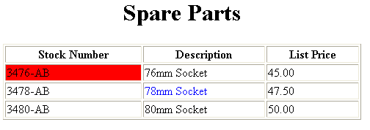
Basic Table Code
<TABLE BORDER=1 width=50%>
<CAPTION> <h1>Spare Parts <h1> </Caption>
<TR><TH>Stock Number</TH><TH>Description</TH><TH>List Price</TH></TR>
<TR><TD bgcolor=red>3476-AB</TD><TD>76mm Socket</TD><TD>45.00</TD></TR>
<TR><TD >3478-AB</TD><TD><font color=blue>78mm Socket</font> </TD><TD>47.50</TD></TR>
<TR><TD>3480-AB</TD><TD>80mm Socket</TD><TD>50.00</TD></TR>
</TABLE>

Slide 57
Table Data and Table Header Attributes
<Table border=1 cellpadding =2>
<tr> <th> Column 1 Header</th> <th> Column 2 Header</th> </tr>
<tr> <td colspan=2> Row 1 Col 1</td> </tr>
<tr> <td rowspan=2>Row 2 Col 1</td>
<td> Row 2 Col2</td> </tr>
<tr> <td> Row 3 Col2</td> </tr>
</table>

Slide 58
Table Data and Table Header Attributes
Column 1 Header | Column 2 Header
Row 1 Col 1
Row 2 Col 1 | Row 2 Col 2
 | Row 3 Col 2

Slide 59
Special Things to Note
TH, TD and TR should always have end tags.
Although the end tags are formally optional, many browsers will mess up the formatting of the table if you omit the end tags. In particular, you should always use end tags if you have a TABLE within a TABLE -- in this situation, the table parser gets hopelessly confused if you don't close your TH, TD and TR elements.
A default TABLE has no borders
By default, tables are drawn without border lines. You need the BORDER attribute to draw the lines.
By default, a table is flush with the left margin
TABLEs are plopped over on the left margin. If you want centered tables, You can either: place the table inside a DIV element with attribute ALIGN="center".
Most current browsers also supports table alignment, using the ALIGN attribute. Allowed values are "left", "right", or "center", for example: <TABLE ALIGN="left">. The values "left" and "right" float the table to the left or right of the page, with text flow allowed around the table. This is entirely equivalent to IMG alignment

Slide 60
What will be the output?
    <TABLE BORDER width=“750”>
    <TR> <TD colspan=“4” align=“center”>Page Banner</TD></TR>
    <TR> <TD rowspan=“2” width=“25%”>Nav Links</TD><TD colspan=“2”>Feature Article</TD> <TD rowspan=“2” width=“25%”>Linked Ads</TD></TR>
    <TR><TD width=“25%”>News Column 1 </TD> <TD width=“25%”><News Column 2 </TD></TR>
    </TABLE>

Slide 61
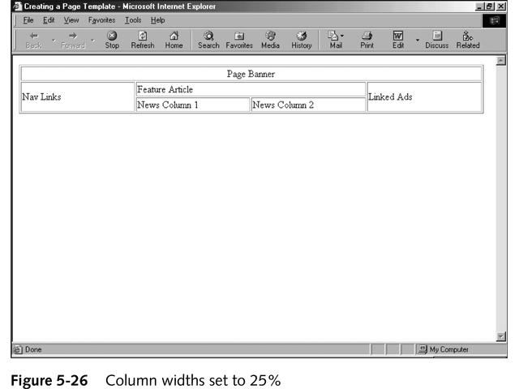
The Output

Slide 62
Frames
Frames are a relatively new addition to the HTML standard. First introduced in Netscape Navigator 2.0.
Objectives:
Upon completing this section, you should be able to:
Create a Frame based page.
Work with the Frameset, Frame, and Noframes elements.
Use the attributes of the Frames elements to control the display.
Set Targets appropriately.

Slide 63
Frames
A framed page is actually made up of multiple HTML pages. There is one HTML document that describes how to break up the single browser window into multiple windowpanes. Each windowpane is filled with an HTML document.
For Example to make a framed page with a windowpane on the left and one on the right requires three HTML pages. Doc1.html and Doc2.html are the pages that contain content. Frames.html is the page that describes the division of the single browser window into two windowpanes.

Slide 64
Frames
Doc1.html
Doc2.html
Doc1.html
Doc2.html
Frames.html

Slide 65
Frame Page Architecture
A <FRAMESET> element is placed in the html document before the <BODY> element. The <FRAMESET> describes the amount of screen real estate given to each windowpane by dividing the screen into ROWS or COLS.
The <FRAMESET> will then contain <FRAME> elements, one per division of the browser window.
Note: Because there is no BODY container, FRAMESET pages can't have background images and background colors associated with them.

Slide 66
Frame Page Architecture
<HTML>
<HEAD>
<TITLE> Framed Page </TITLE>
<FRAMeSET COLS=“23%,77%”>
<FRAME SRC=“Doc1.html”>
<FRAME SRC=“Doc2.html”>
</FRAMeSET >
</HEAD>
</HTML>

Slide 67
The Diagram below is a graphical view of the document described above
FRAMESET COLS=”23%, 77%”
FRAME
NAME= left_pane
SRC=Doc1.html
FRAME
NAME=right_pane
SRC= Doc2.html

Slide 68
Compound FRAMESET Divisions Example
<HEAD>
<FRAMESET ROWS="25%,50%,25%”
<FRAME SRC="">
  <FRAMESET COLS="25%,*">
<FRAME SRC="">
<FRAME SRC="">
</FRAMESET>
<FRAME SRC="">
</FRAMESET>
</HEAD>

Slide 69
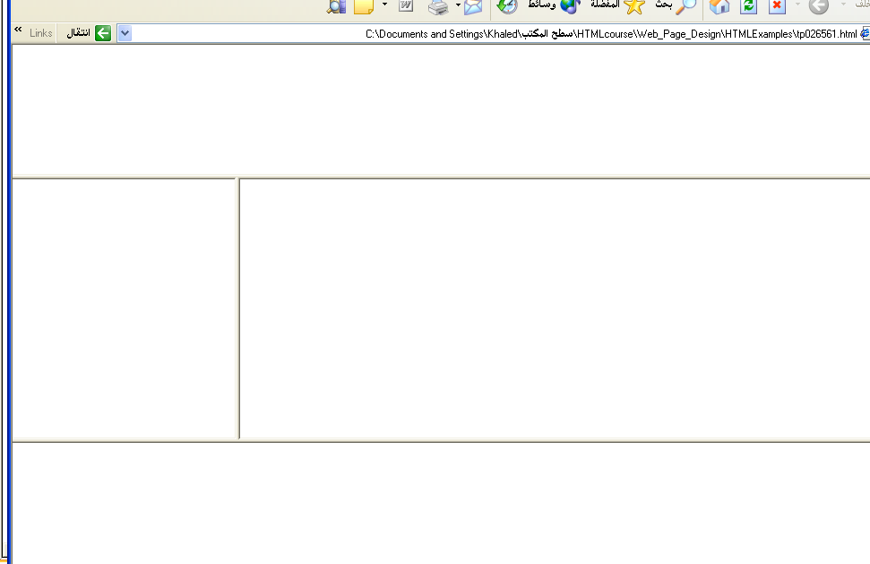
Output

Slide 70
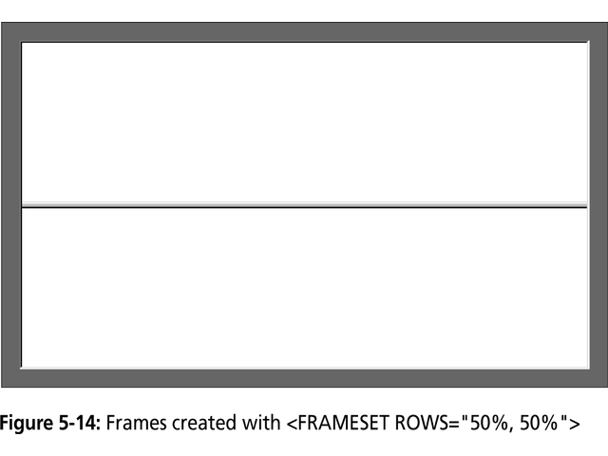

Slide 71
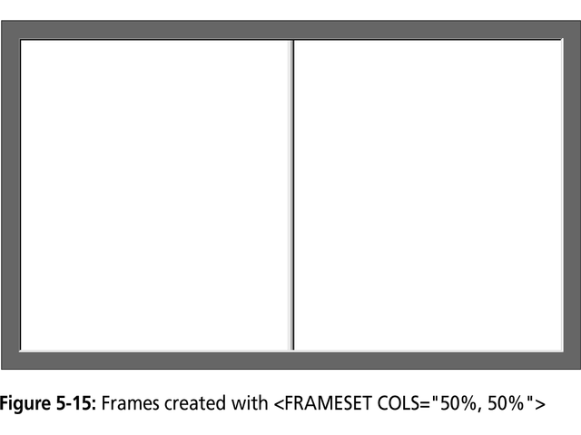

Slide 72
